Slide 1

6th Grade Math
Unit 4, Lesson 9 Absolute Value – Part 2 Volume 1, pg. 179

Slide 2


Benchmark
MA.6.NSO.1.3
Given a mathematical or real-world context, interpret the absolute value of a number as the distance from zero on a number line. Find the absolute value of rational numbers.
volume 1, pg. 179

Slide 3
Integrated Mathematical Thinking and Reasoning Standards
MA.K12.MTR.2.1 Demonstrate understanding by representing problems in multiple ways.
MA.K12.MTR.7.1 Apply mathematics to real-world contexts.
volume 1, pg. 179

Slide 4

Learning Target
I can find the absolute value of a value and interpret it within the context.
volume 1, pg. 179

Slide 5

Warm-Up
volume 1, pg. 179

Slide 6
4.9.1 Warm-Up: Absolute Value
Choose any value 1 through 9, along with its opposite, to complete the statement below:
____ and ____ are ____ units away from _____ on the
number line.
Switch your answer with a partner to check.
Ask your partner their strategy for finding their answer and write their strategy below.
volume 1, pg. 179

Slide 7

Guided Practice
volume 1, pg. 180

Slide 8

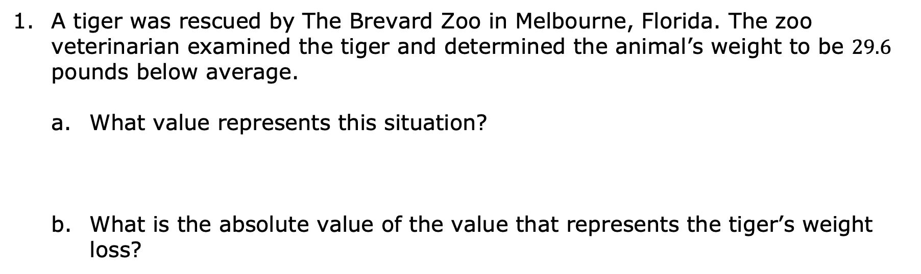
4.9.2 Guided Practice: Absolute Value and Opposites in the Real World
A tiger was rescued by The Brevard Zoo in Melbourne, Florida. The zoo veterinarian examined the tiger and determined the animal’s weight to be $29.6$ pounds below average.
What value represents this situation?
What is the absolute value of the value that represents the tiger’s weight loss?
volume 1, pg. 180

Slide 9
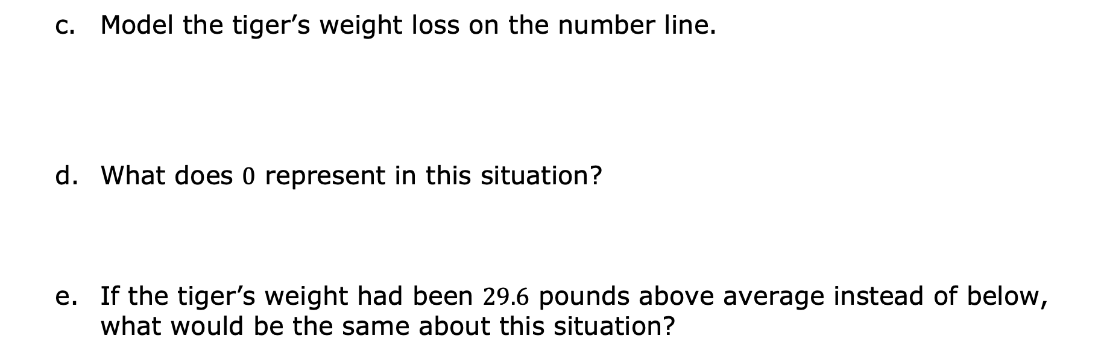
Model the tiger’s weight loss on the number line.
What does $0$ represent in this situation?
If the tiger’s weight had been $29.6$ pounds above average instead of below, what would be the same about this situation?
volume 1, pg. 180

Slide 10
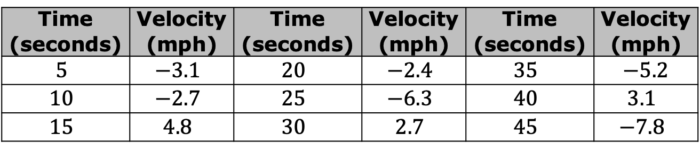
Simone is doing research on different rides at the Strawberry Festival. She attaches an accelerator to a bumper car to measure the velocity of her car. She recorded the velocities, in miles per hour (mph), in the table.
Determine when the bumper car is at the same speed. List the times and the speed of the car at those times.
Speed is the absolute value of velocity.
Time (seconds) | Velocity (mph) | Time (seconds) | Velocity (mph) | Time (seconds) | Velocity (mph)
$$5$$ | $$−3.1$$ | $$20$$ | $$−2.4$$ | $$35$$ | $−5.2$
$$10$$ | $$−2.7$$ | $$25$$ | $$−6.3$$ | $$40$$ | $$3.1$$
$$15$$ | $$4.8$$ | $$30$$ | $$2.7$$ | $$45$$ | $$−7.8$$
volume 1, pg. 180

Slide 11
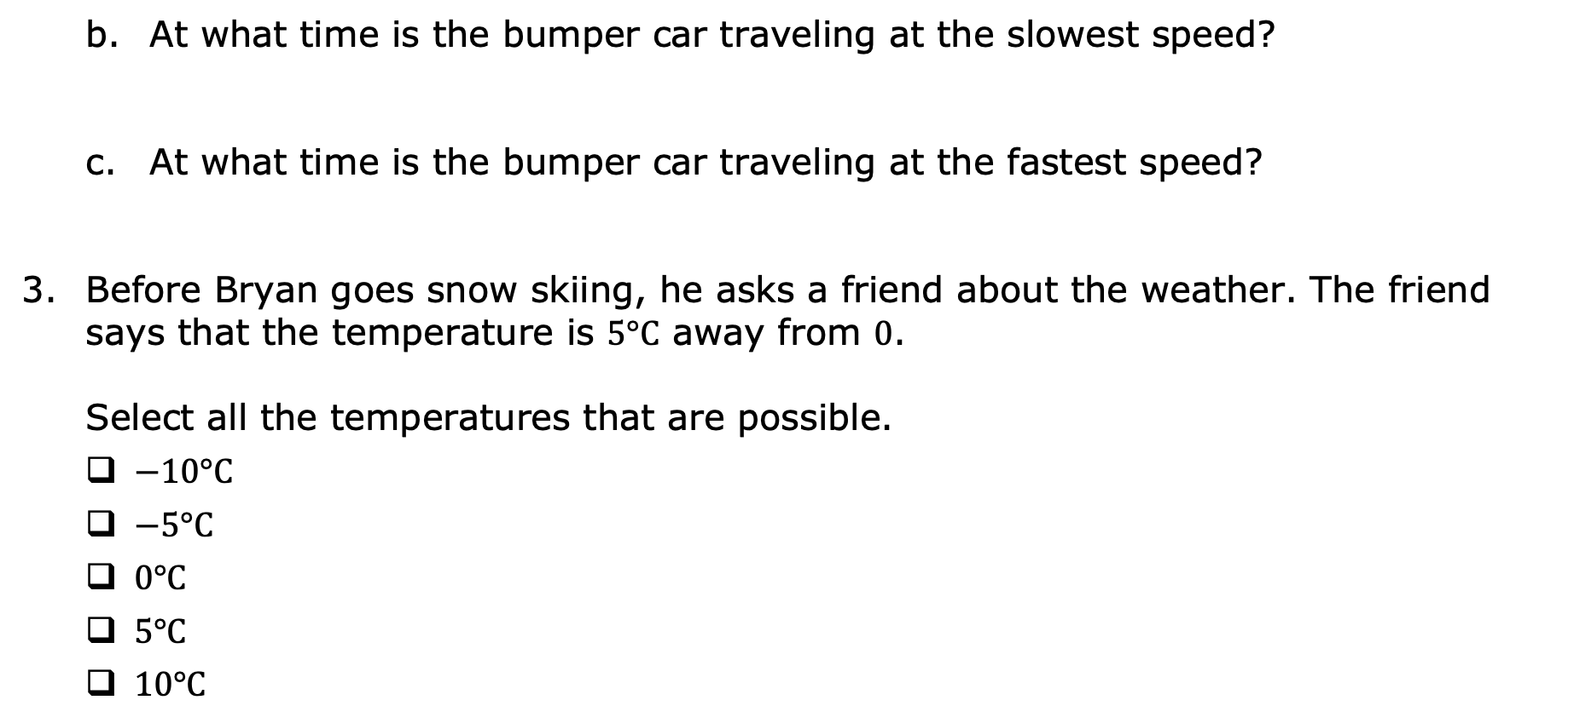
At what time is the bumper car traveling at the slowest speed?
At what time is the bumper car traveling at the fastest speed?
Before Bryan goes snow skiing, he asks a friend about the weather. The friend says that the temperature is $5°C$ away from $0$. Select all the temperatures that are possible.
$−10°C$
$−5°C$
$0°C$
$5°C$
$10°C$
volume 1, pg. 180

Slide 12
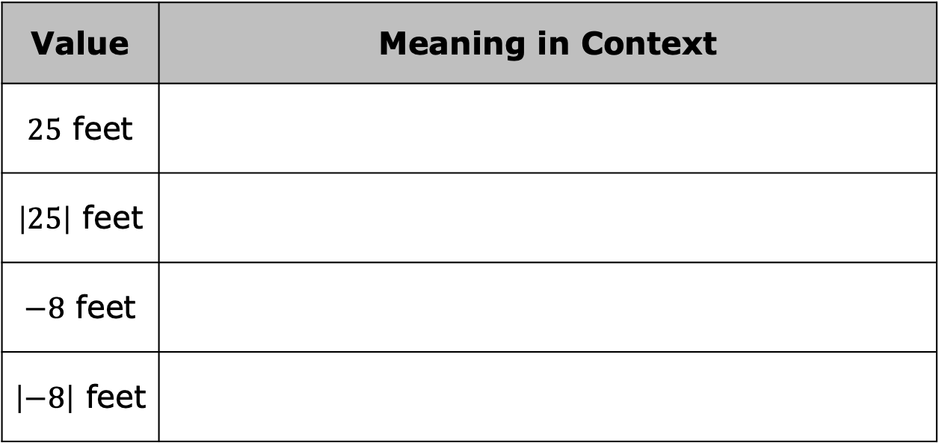
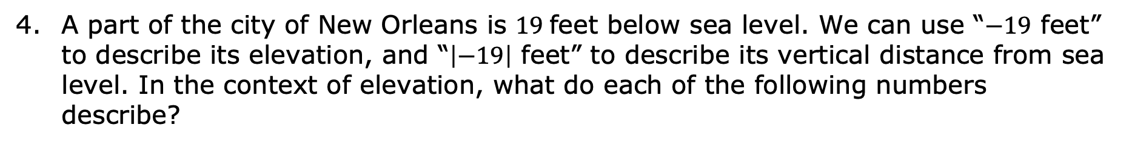
A part of the city of New Orleans is $19$feet below sea level. We can use “$−19$ feet” to describe its elevation, and “$\left|−19\right|$ feet” to describe its vertical distance from sea level. In the context of elevation, what do each of the following numbers describe?
Value | Meaning in Context
$25$ feet
$\left|25\right|$ feet
$−8$ feet
$\left|−8\right|$ feet
volume 1, pg. 181

Slide 13

Collaboration
volume 1, pg. 181

Slide 14

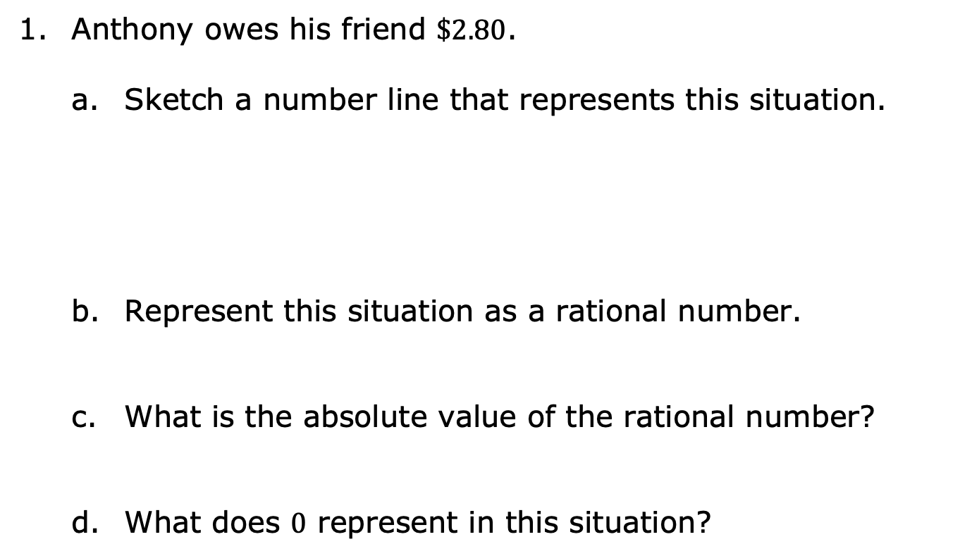
4.9.3 Collaboration: Absolute Value and Opposites in the Real World
Anthony owes his friend $\$2.80$.
Sketch a number line that represents this situation.
Represent this situation as a rational number.
What is the absolute value of the rational number?
What does $0$ represent in this situation?
volume 1, pg. 181

Slide 15
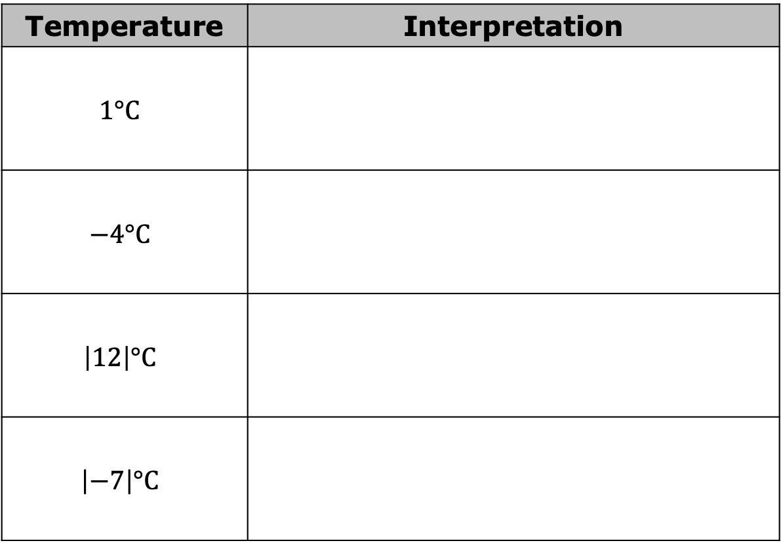
With your partner, describe the meaning of each value in the context of temperature, where the freezing point is $0℃$.
Temperature | Interpretation
$$1°C$$
$$−4°C$$
$$\left|12\right|°C$$
$$\left|−7\right|°C$$
volume 1, pg. 182

Slide 16

Your Turn
volume 1, pg. 182

Slide 17
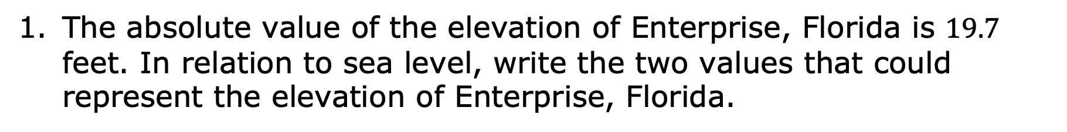
4.9.4 Your Turn!
The absolute value of the elevation of Enterprise, Florida is $19.7$ feet. In relation to sea level, write the two values that could represent the elevation of Enterprise, Florida.
volume 1, pg. 182

Slide 18
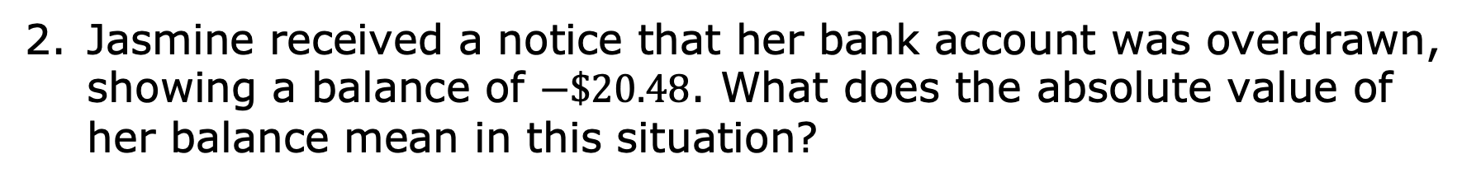
Jasmine received a notice that her bank account was overdrawn, showing a balance of $−\$20.48$. What does the absolute value of her balance mean in this situation?
volume 1, pg. 182

Slide 19

Wrap-Up
volume 1, pg. 183

Slide 20
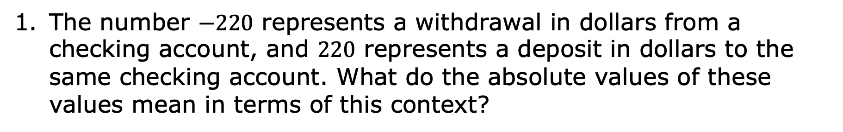
4.9.5 Wrap-Up: Ticket Out the Door
The number $−220$ represents a withdrawal in dollars from a checking account, and $220$ represents a deposit in dollars to the same checking account. What do the absolute values of these values mean in terms of this context?
volume 1, pg. 183

Slide 21
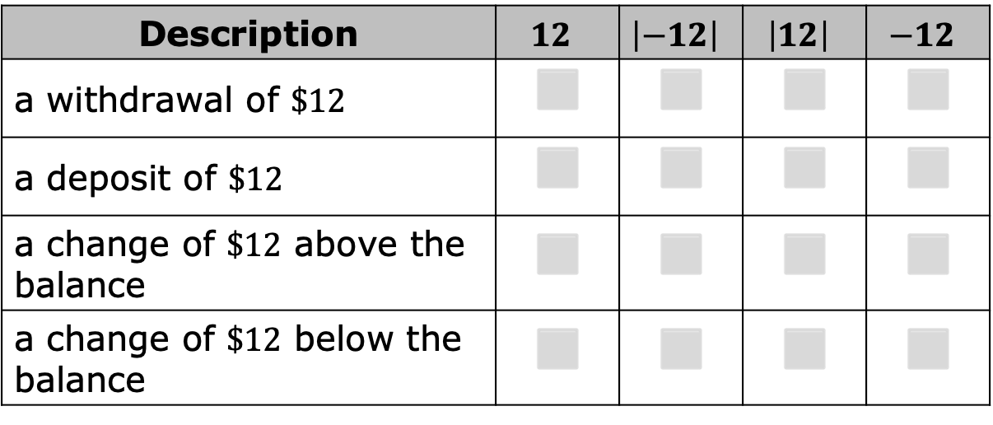
A bank account has an account balance of $\$150$. For each description, check the value(s) of each expression that correctly matches.
Description | $$12$$ | $$\left|−12\right|$$ | $$\left|12\right|$$ | $$−12$$
a withdrawal of $\$12$ | ◻ | ◻ | ◻ | ◻
a deposit of $\$12$ | ◻ | ◻ | ◻ | ◻
a change of $\$12$ above the balance | ◻ | ◻ | ◻ | ◻
a change of $\$12$ below the balance | ◻ | ◻ | ◻ | ◻
volume 1, pg. 183

